Slide 1
Group 4
  Puzzle Solver Using Different Algorithms
  Group Members:
                Habib Foysal ID: 2122284642
                Emrose Khan ID: 2011932642
                Md Nazmus Saqib ID: 2021696642
                Ashikur Rahman Ashik ID: 2111632642
                Masud Shahriar ID: 2021850642

Slide 2
INTRODUCTION
  OUR PUZZLE SOLVER IS A PYTHON-BASED PROJECT
  IT SOLVES TWO CLASSIC PUZZLES: 8-PUZZLE AND SUDOKU
  USER-FRIENDLY SETUP
  CUSTOM INPUT AND ALGORITHM SELECTION
  DISPLAYS THE TOTAL TIME TAKEN TO SOLVE THE PUZZLE
  HELPS THE USER TO COMPARE PERFORMANCE

Slide 3
PROBLEM DESCRIPTION
  A PUZZLE SOLVER THAT EFFICIENTLY TACKLES DIVERSE PUZZLES
  USES MULTIPLE SEARCH ALGORITHMS
  CUSTOMIZED HEURISTICS FOR INFORMED SEARCHES
  CUSTOM USER INPUT AND ALGORITHM SELECTION
  PERFORMANCE COMPARISON

Slide 4
TYPES OF ALGORITHMS
8-PUZZLE:
  BFS (BREADTH FIRST SEARCH)
  DFS (DEPTH-FIRST SEARCH)
  A* (WITH A MANHATTAN DISTANCE HEURISTIC)
SUDOKU:
  BASIC BACKTRACKING
  ADVANCED BACKTRACKING (WITH THE MINIMUM REMAINING VALUE HEURISTIC)

Slide 5
DESIGN OVERVIEW
MODULAR STRUCTURE:
  8-PUZZLE MODULE: CONTAINS THE EIGHT PUZZLE CLASS, METHODS FOR GENERATING NEW STATES, AND IMPLEMENTATIONS OF THREE SEARCH ALGORITHMS
  SUDOKU MODULE: IMPLEMENTS RECURSIVE BACKTRACKING WITH TWO ALGORITHM VARIANTS

Slide 6
DESIGN OVERVIEW
USER INPUT/OUTPUT MECHANISMS:
  INPUT: THE PROGRAM INTERACTS WITH THE USER VIA THE COMMAND LINE. FOR THE 8-PUZZLE, THE USER INPUTS A FLAT SEQUENCE OF 9 NUMBERS REPRESENTING THE GRID, WHILE FOR SUDOKU, THE USER ENTERS 9 ROWS WITH 9 NUMBERS EACH. THE NUMBER ZERO (0) REPRESENTS BLANK SPACE
  ALGORITHM SELECTION: USER SELECTS ALGORITHM TO SOLVE
  OUTPUT: THE SYSTEM PRESENTS THE SOLUTION PATH OR FINAL SOLVED PUZZLE, ALONG WITH PERFORMANCE METRICS

Slide 7
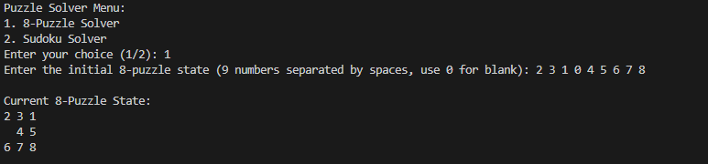
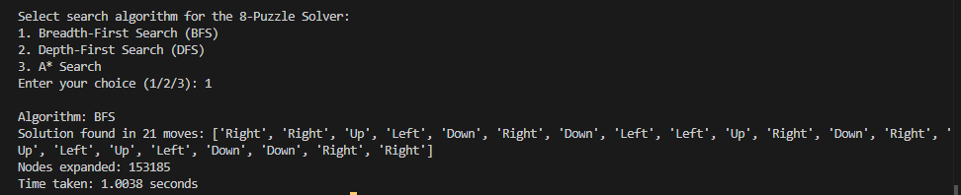
PERFORMANCE
  8 PUZZLE

Slide 8
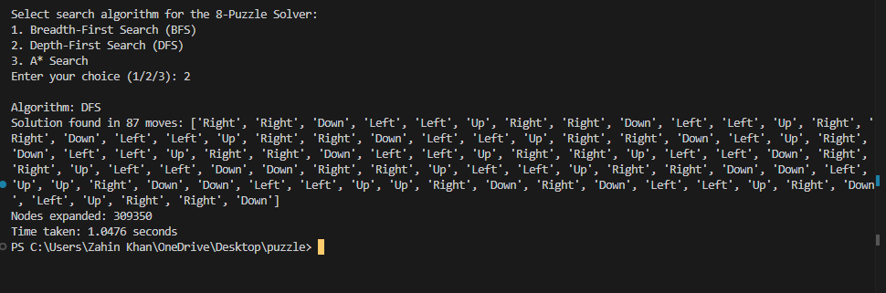
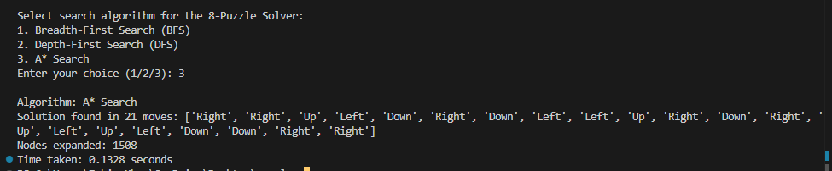
PERFORMANCE
  8 PUZZLE

Slide 9
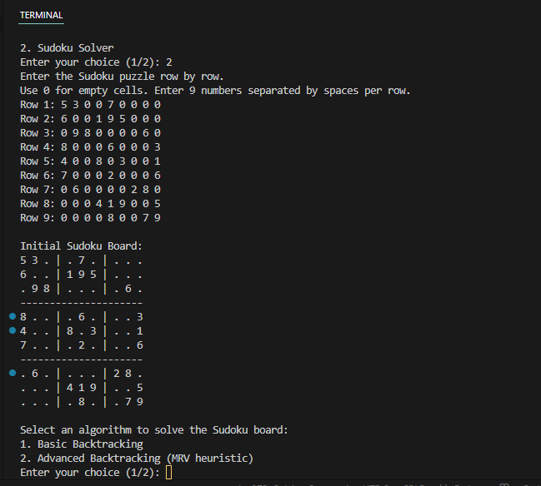
PERFORMANCE
  SUDOKU

Slide 10
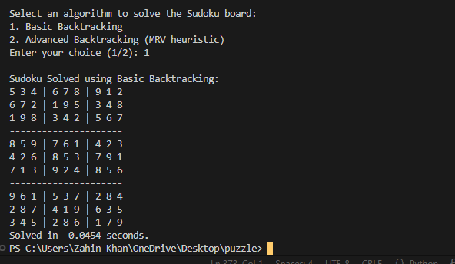
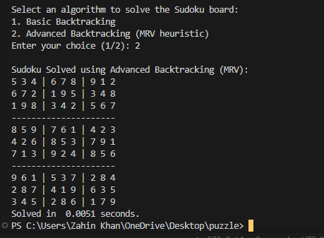
PERFORMANCE
  SUDOKU

Slide 11
CHALLENGES
  THE PROJECT NEEDED TO SUPPORT BOTH THE 8-PUZZLE AND SUDOKU PUZZLES IN ONE CODEBASE
  MUST TAKE USER INPUTS AND ALLOW USERS TO SELECT AN ALGORITHM
  ROBUST USER INPUT HANDLING
  MANAGING SEARCH LIMITS IN DFS

Slide 12
SOLUTIONS
  A MODULAR DESIGN WAS ADOPTED—SEPARATING THE 8-PUZZLE AND SUDOKU FUNCTIONALITIES INTO DISTINCT MODULES
  THREE SEARCH ALGORITHMS WERE IMPLEMENTED TO SOLVE THE 8-PUZZLE, AND TWO OTHER ALGORITHMS WERE IMPLEMENTED TO SOLVE THE SUDOKU
  TIME FUNCTIONS AND COUNTERS WERE INTEGRATED FOR THE USER TO COMPARE PERFORMANCES
  TRY-EXCEPT BLOCKS AND VALIDATION LOGIC ENSURED THAT THE USER PROVIDED THE EXPECTED DATA FORMAT
  ERROR MESSAGES WERE PROVIDED WHEN THE INPUT WAS INVALID, ALLOWING THE USER TO RETRY.

Slide 13
CONCLUSION
WE SUCCESSFULLY DEVELOPED A PUZZLE SOLVER THAT IS CAPABLE OF TACKLING BOTH THE 8-PUZZLE AND SUDOKU CHALLENGES. BY IMPLEMENTING A VARIETY OF ALGORITHMS AND HEURISTICS, WE PROVIDED USERS WITH FLEXIBLE AND EFFICIENT SOLUTIONS. THE MODULAR DESIGN ENSURES THAT THE CODE IS EASY TO MAINTAIN AND EXPAND IN THE FUTURE. THIS PROJECT NOT ONLY ACHIEVED ITS OBJECTIVES BUT ALSO ESTABLISHED A STRONG FOUNDATION FOR FURTHER EXPLORATION OF PUZZLE-SOLVING ALGORITHMS AND THEIR APPLICATIONS
Thank You

